Slide 1

Syslog

Slide 2
What is Syslog?
Syslog protocol is used for decades as a way to transport messages from network devices to a logging server, typically known as a syslog server.
The syslog protocol has support on most major operating systems, including macOS, Linux, and Unix. Syslog can also be supported on Microsoft Windows via third-party tools.

Slide 3
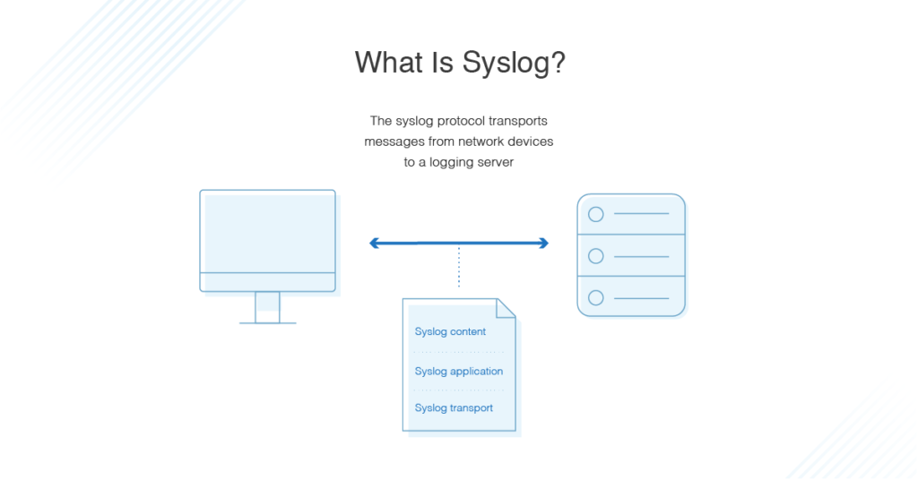
What is Syslog?

Slide 4
Syslog Layers
Syslog has three layers as part of the standard definition:
Syslog content: The information in the event message
Syslog application: The layer that generates, routes, interprets, and stores the message
Syslog transport: The layer that transmits the message

Slide 5
What Does Syslog Do?
Syslog provides a way for network devices to send messages and log events.
Syslog has a standard format all applications and devices can use.
A syslog message contains the following elements:
Header
Structured data
Message

Slide 6
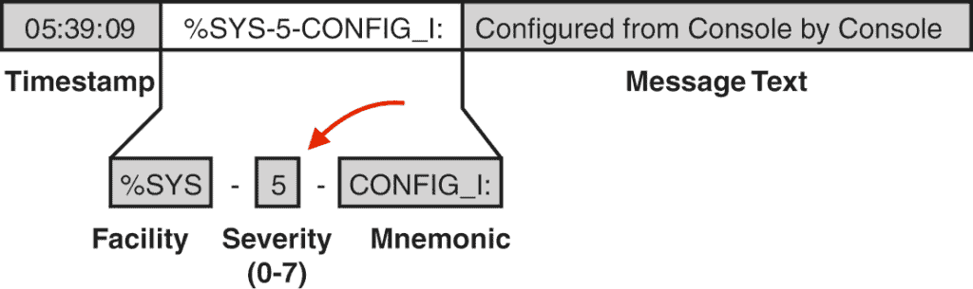
Syslog Header
The header includes information about the version, time stamp, host name, priority, application, process ID, and message ID.
The structured data comprises data blocks in a specific format, which is followed by the log message.

Slide 7
Syslog Header
Log messages should be encoded using the 8-bit Unicode Transformation Format (UTF-8), but apart from that, the messages can be configured based on individual needs.
The flexibility of the message content is part of what makes syslog so popular and effective.
The severity levels for syslog messages range from 0, which signals an emergency, to 5, which constitutes a warning.

Slide 8
Syslog Header
There are additional options for informational messages (level 6) and debugging (level 7).
While this information is advantageous, you can’t use syslog to gather information from devices the way you can with Simple Network Management Protocol (SNMP).
Syslog only supports sending messages to a defined location when certain events happen.

Slide 9
Syslog vs. Event Log
In contrast to syslog, an event log is a more basic resource that stores different types of information based on specific events. These events include:
Failed password attempts
Locked accounts
Network login sessions
Application errors
Unexpected application closures

Slide 10
Syslog vs. Event Log
Event logs can be used to troubleshoot problems with security management, application installations, and more. The Windows event log includes the following information for each entry:
Date: Date when the event occurred
Time: Time when the event occurred
User: User logged in when the event occurred
Computer: Name of the computer used
Event ID: An identification number from Windows indicating the event type
Source: Component or program that caused the event
Type: Type of event

Slide 11
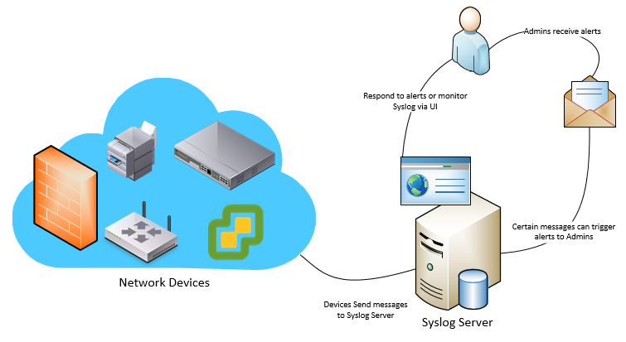
What Is Syslog Server?
Syslog servers are used to collect syslog messages in a single location. A syslog server might be a physical server, a standalone virtual machine, or a software-based service.

Slide 12
What Is Syslog Server?
To make it possible for syslog servers to receive, interpret, and store the messages, they usually have a couple of common components:
Syslog Listener: This allows the server to receive messages by gathering Syslog data.
Database: This is important for larger networks to be able to store syslog data for easy reference.

Slide 13
Thank You

